Slide 1
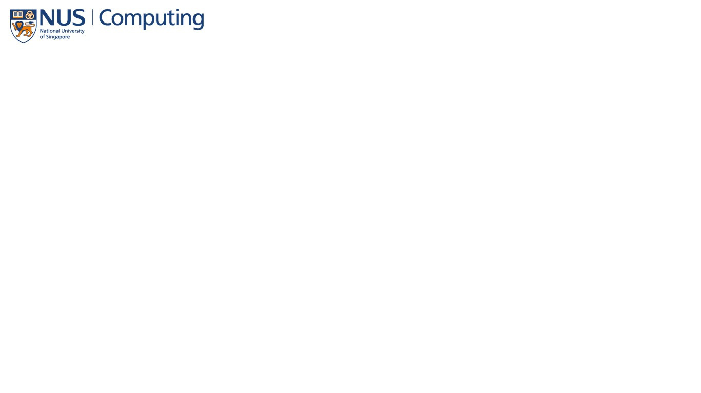

Characteristics
of
popular apps
story telling
Google Play Store Apps Dataset
group number:SW3019_05

Slide 2
Back
ground
Data Cleaning
Data Visualisation
Introduction of dataset and time period and motivation......
How we clean the google play store dataset
four part questions and one main quesiton

Slide 3
1.dataset introduction
3.Target Audience
general public
application developers
source of the dataset?
time period?
how many files of the dataset
what are the dimensions
4.Intended effect
what hot points nowadays
what are factors at the back
help application developers develop excellent apps
2.Motivation
Background
We are application developers
look through the behavior of the market
through our data analysis and visualization
how the hot application successed

Slide 4
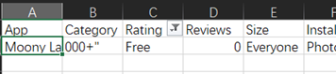

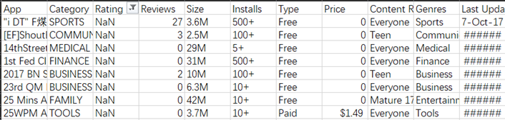

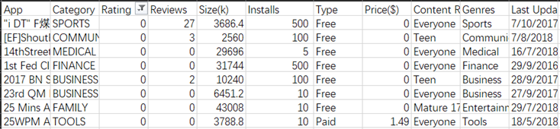
Dislocation
1.googleplaystore
Modify dislocation
Rating : NaN->0
app list : delete the repetition
size list : Convert Mb to Kb and delete the unit
installs list : delete the ‘+’
Last Update : Unified formula
category list : replace the null with Other
Price: delete the $
Data Cleaning
2.googleplay_user_reviews
Modify dislocation
delete the null value reviews
delete the redundancy review record

Slide 5
Characteristics of popular apps.
Data Visualisation

Slide 6

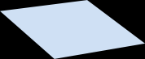


1.What's the most popular categories of apps?
3.Do regular updates contribute to
popularity of an app?
2.How an app's size contribute to its popularity?
演示文稿是一种交流工具，可以用作演示、讲座、演讲、报告等。演示文稿是一种交流工具。
4.Whats the ideal price range of an app?
演示文稿是一种交流工具，可以用作演示、讲座、演讲、报告等。演示文稿是一种交流工具。
演示文稿是一种交流工具，可以用作演示、讲座、演讲、报告等。演示文稿是一种交流工具。

Slide 7

Characteristics
What's the most popular categories of apps?

Slide 8
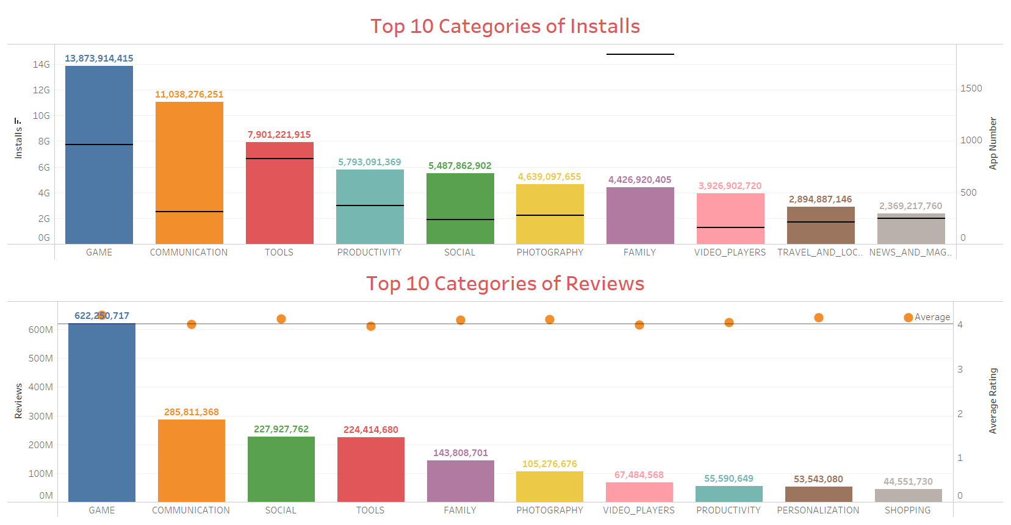
The Game has the most Installs.
But the Communication has less number of App.
Installs can reflect the number of app users.
The Game’s rating is higher than the Average.
The Game has twice the number of reviews with the Communication.
Reviews can reflect the number of active users.

Slide 9
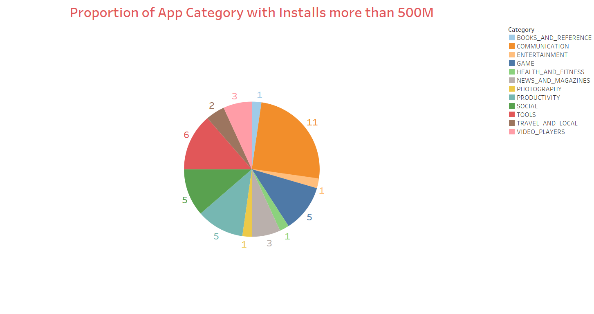
1. COMMUNICATION
2. TOOLS
3. SOCIAL
In the most popular Apps, the Communication occupies one quarter, while the Game is ranked the third.
3. GAME
3. PRODUCTIVITY

Slide 10
Conclusion
•The Game is the most popular category as it has the most amount of installs and reviews, while keeping high rating.
•However, the Communication also has many installs and reviews. The key is that there are many most popular Apps in this category. So the Communication is a popular category, too.

Slide 11
Characteristics
How an app's size contribute to its popularity?

Slide 12
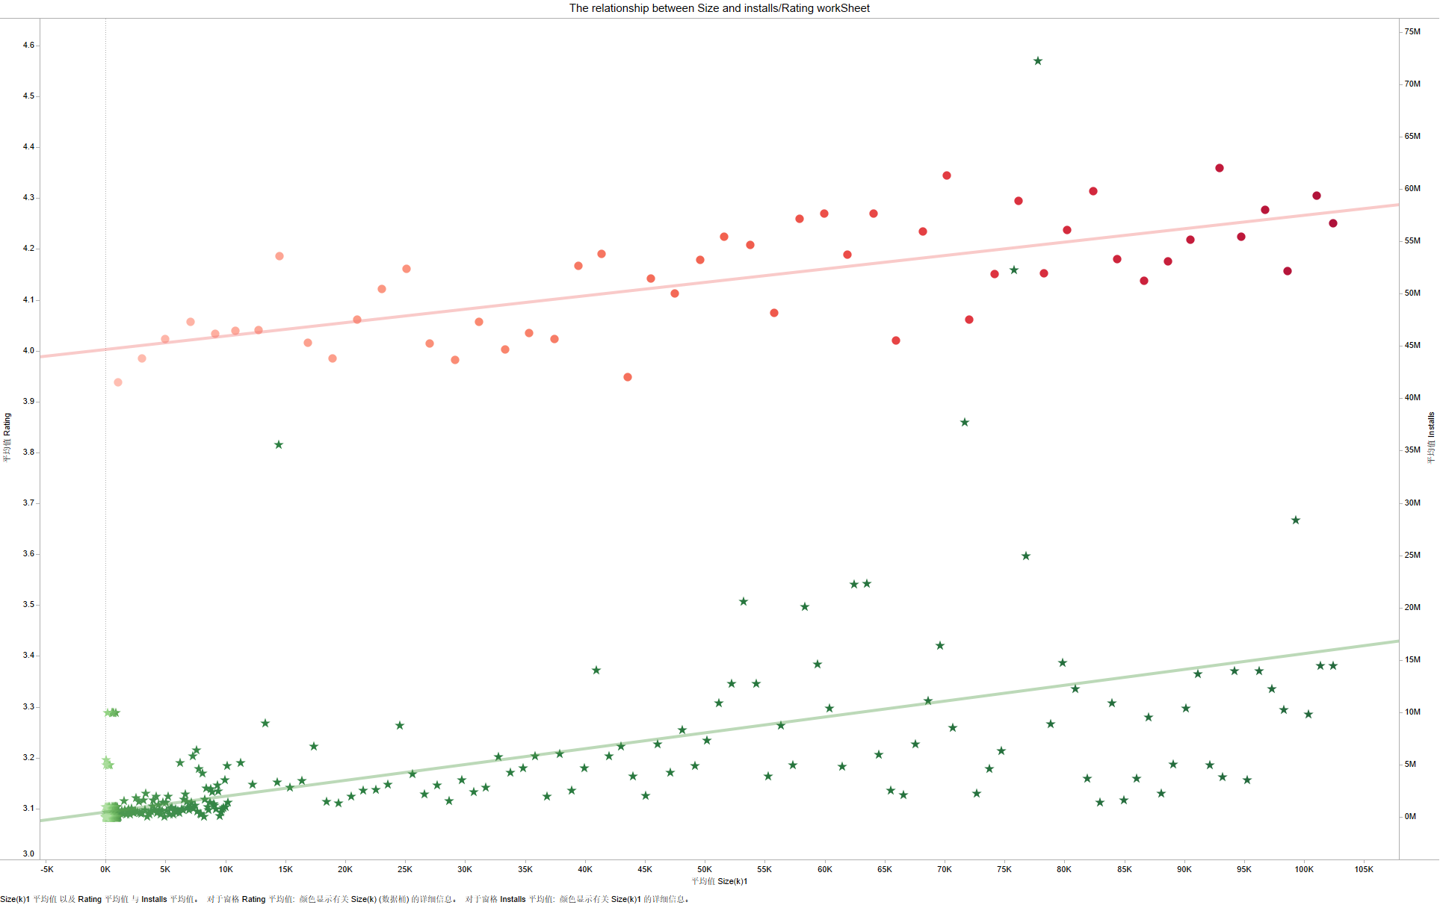
The relationship between size and rating size and installations
The red trend line：The bigger applications may receive higher rating
The green trend line The bigger applications may receive more installations

Slide 13
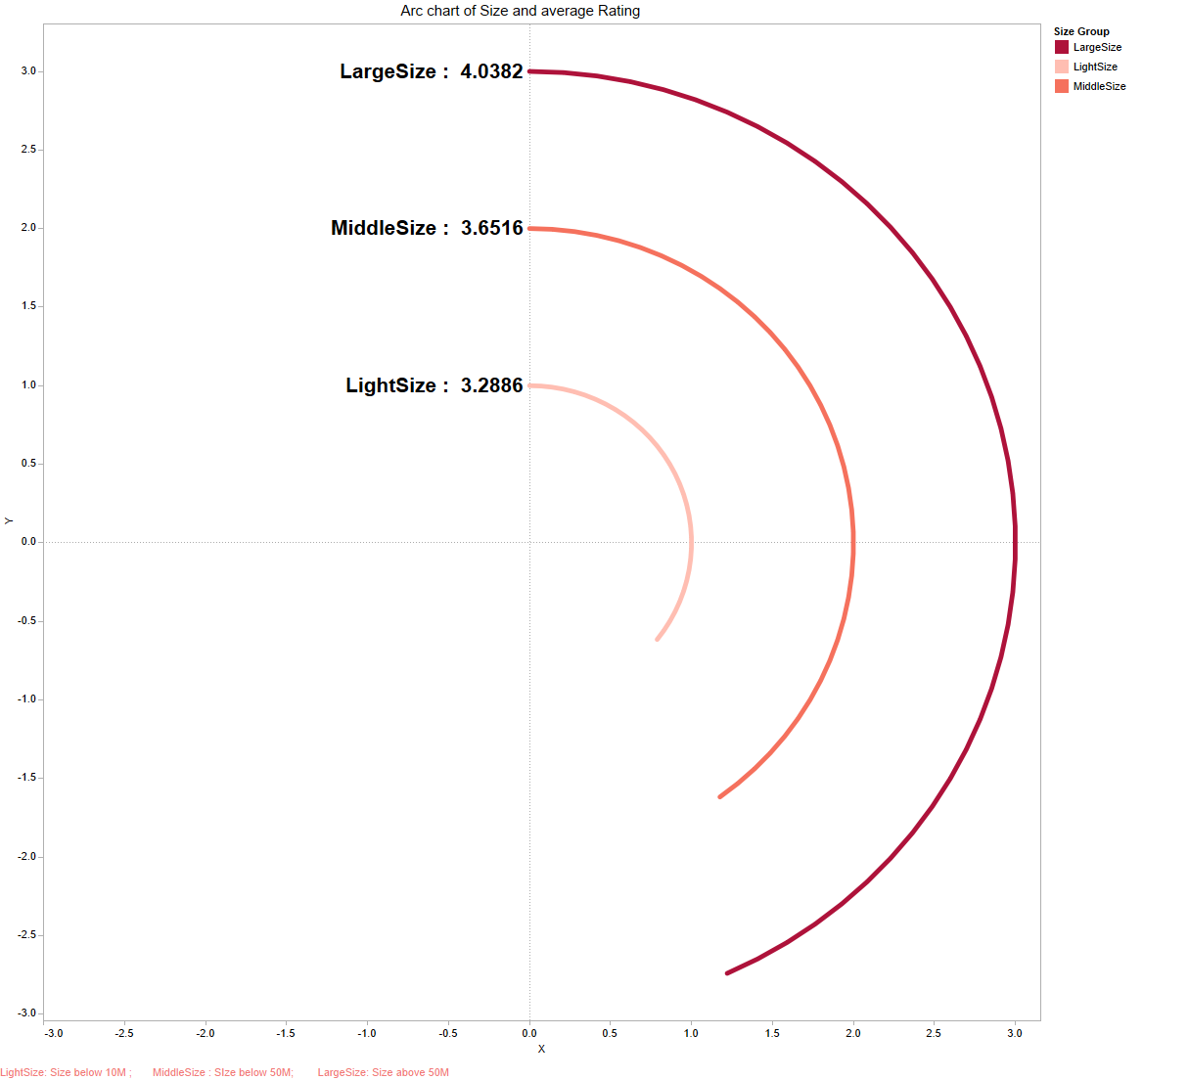
Average rating in different size group
The apps in largeSize group have the highest average Rating
Size group:
LightSize: Size below 10M
MiddleSize : SIze below 50M
LargeSize: Size above 50M
The apps in LightSize group have the lowest average Rating

Slide 14
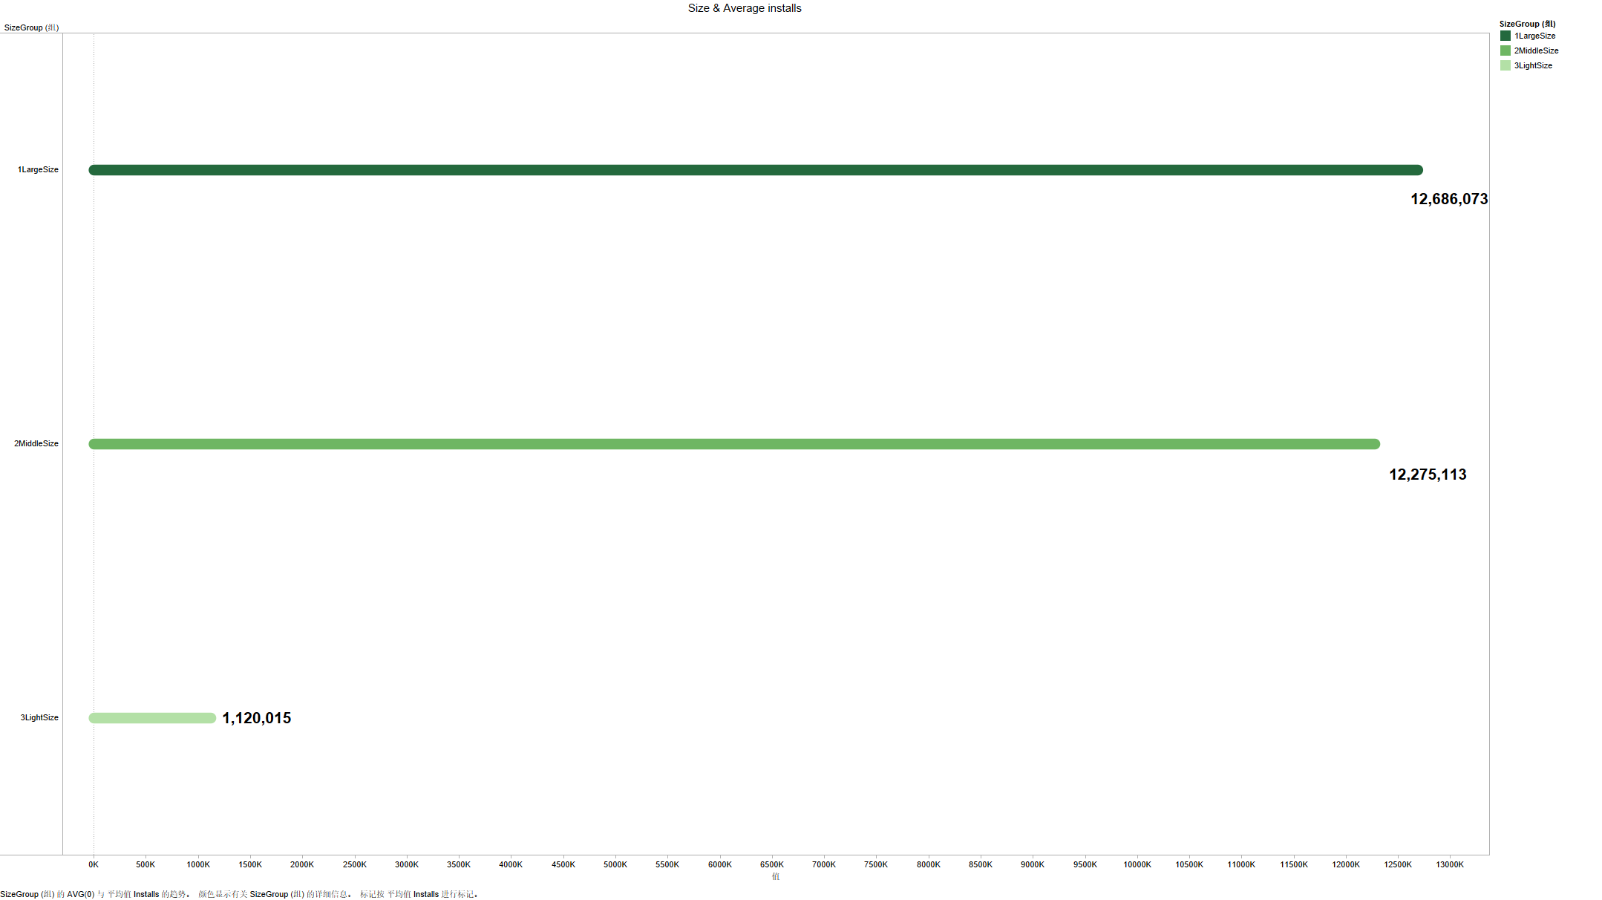
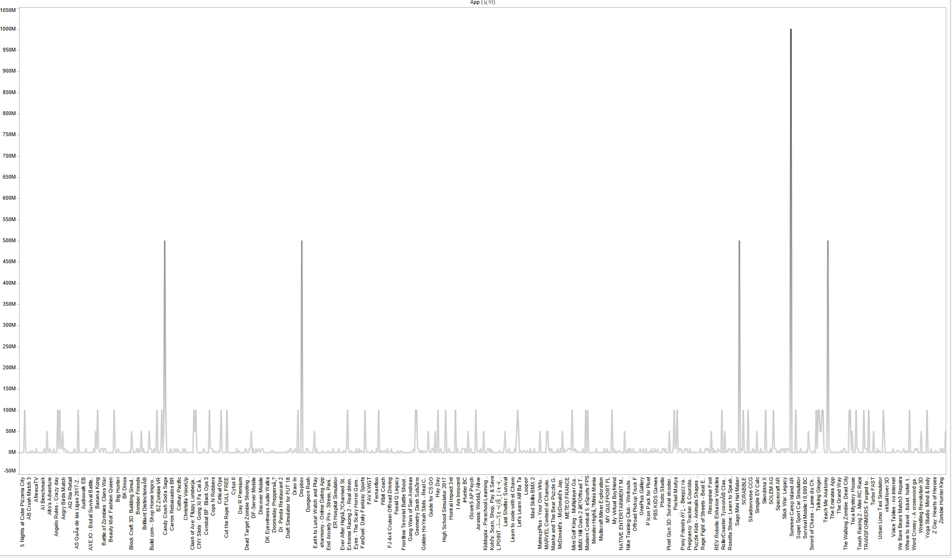
The average installations in different Size group
The average installations in LargeSize are slightly more than that in MiddleSize
the line chart on the right shows that only few apps In light sIze group are popular, So they have the least average installations
LightSize: Size below 10M
MiddleSize : Size below 50M
LargeSize: Size above 50M

Slide 15
Conclusion
the larger apps seem to get great popularity and favorable comment. Consequently, you app developers add as many great features and ideas as possible to you application, regardless of the size of the it. And the large excellent app will become a surprise hit.

Slide 16
Characteristics
Do regular updates contribute to
popularity of an app?

Slide 17
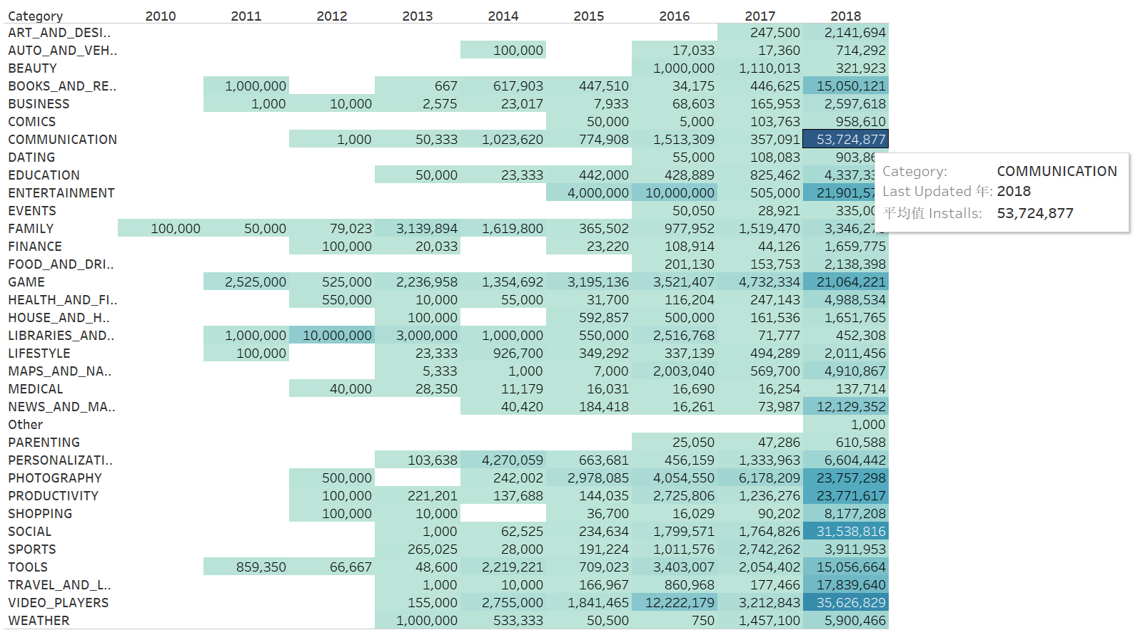
Do year of Last Updated contributed to the installs in category

Slide 18
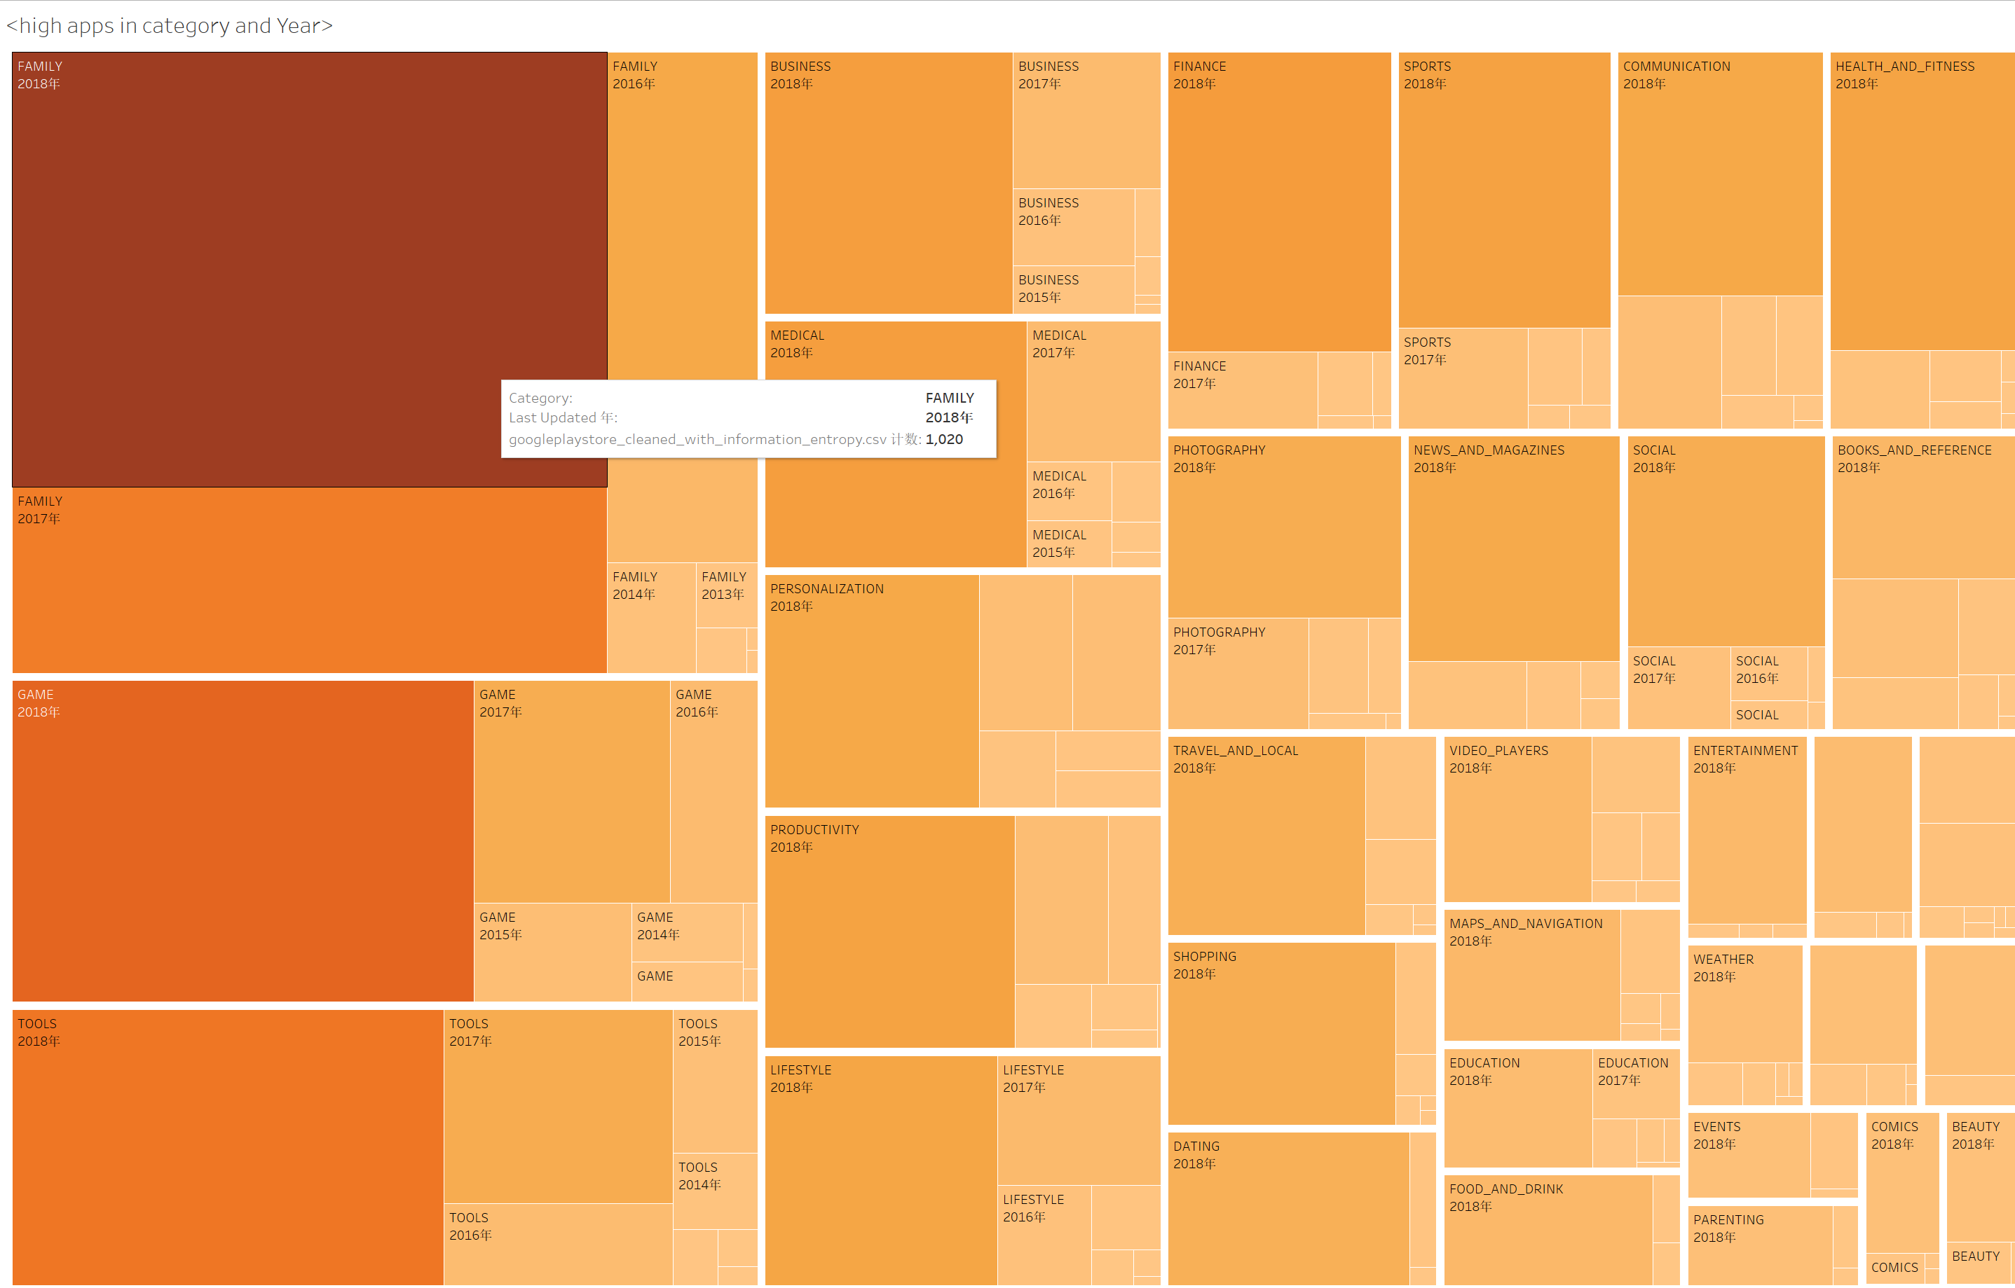
Do year of Last Updated contributed to the apps in category?
FAMILY has the most apps in 2018

Slide 19
Characteristics
What are the ideal price range of an app?

Slide 20
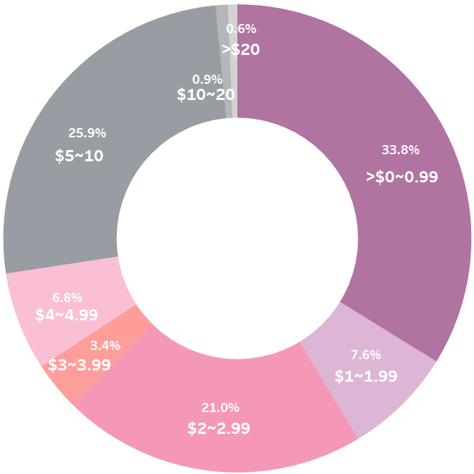
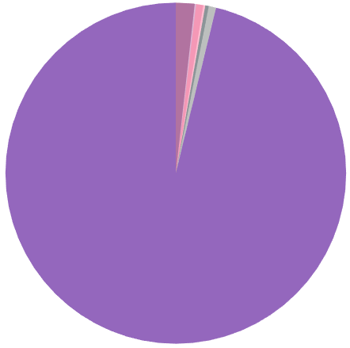
Users consider price too
Apps less than $5 will probably receive nearly 3 quarters of the rest installations. (free apps exclusive)
Total installations of different price ranges.
Free apps dominate.
People prefer cheaper apps
We can conclude…
People prefer cheaper apps.
Control the price from too high.
Insert ads or introduce extra paid-services …
$0
Most users download free apps

Slide 21
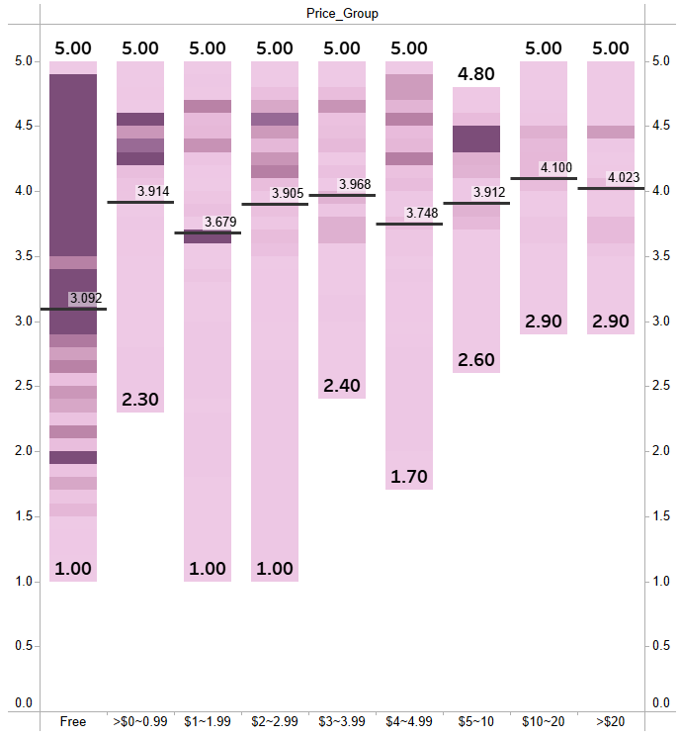
Distribution of rating in different price ranges
Maximum, minimum and the average…
Darker patterns denote more installations.
We can conclude…
Paid apps with higher rating win more installations correspondingly.
Users may consider more when needing to pay.
Paid apps with high installations are generally above 4.0.

Slide 22
Thanks
SW3019_05

